Slide 1
Job Recommendations at XING
Data Science Portugal Meet-up,
Porto, 14th May 2018
Katja Niemann

Slide 2
Outline
Challenges and Algorithms
Building Recommender Systems
Deployment of RecSys Models
Q&A

Slide 3
RecSys Challenges and Algorithms

Slide 4
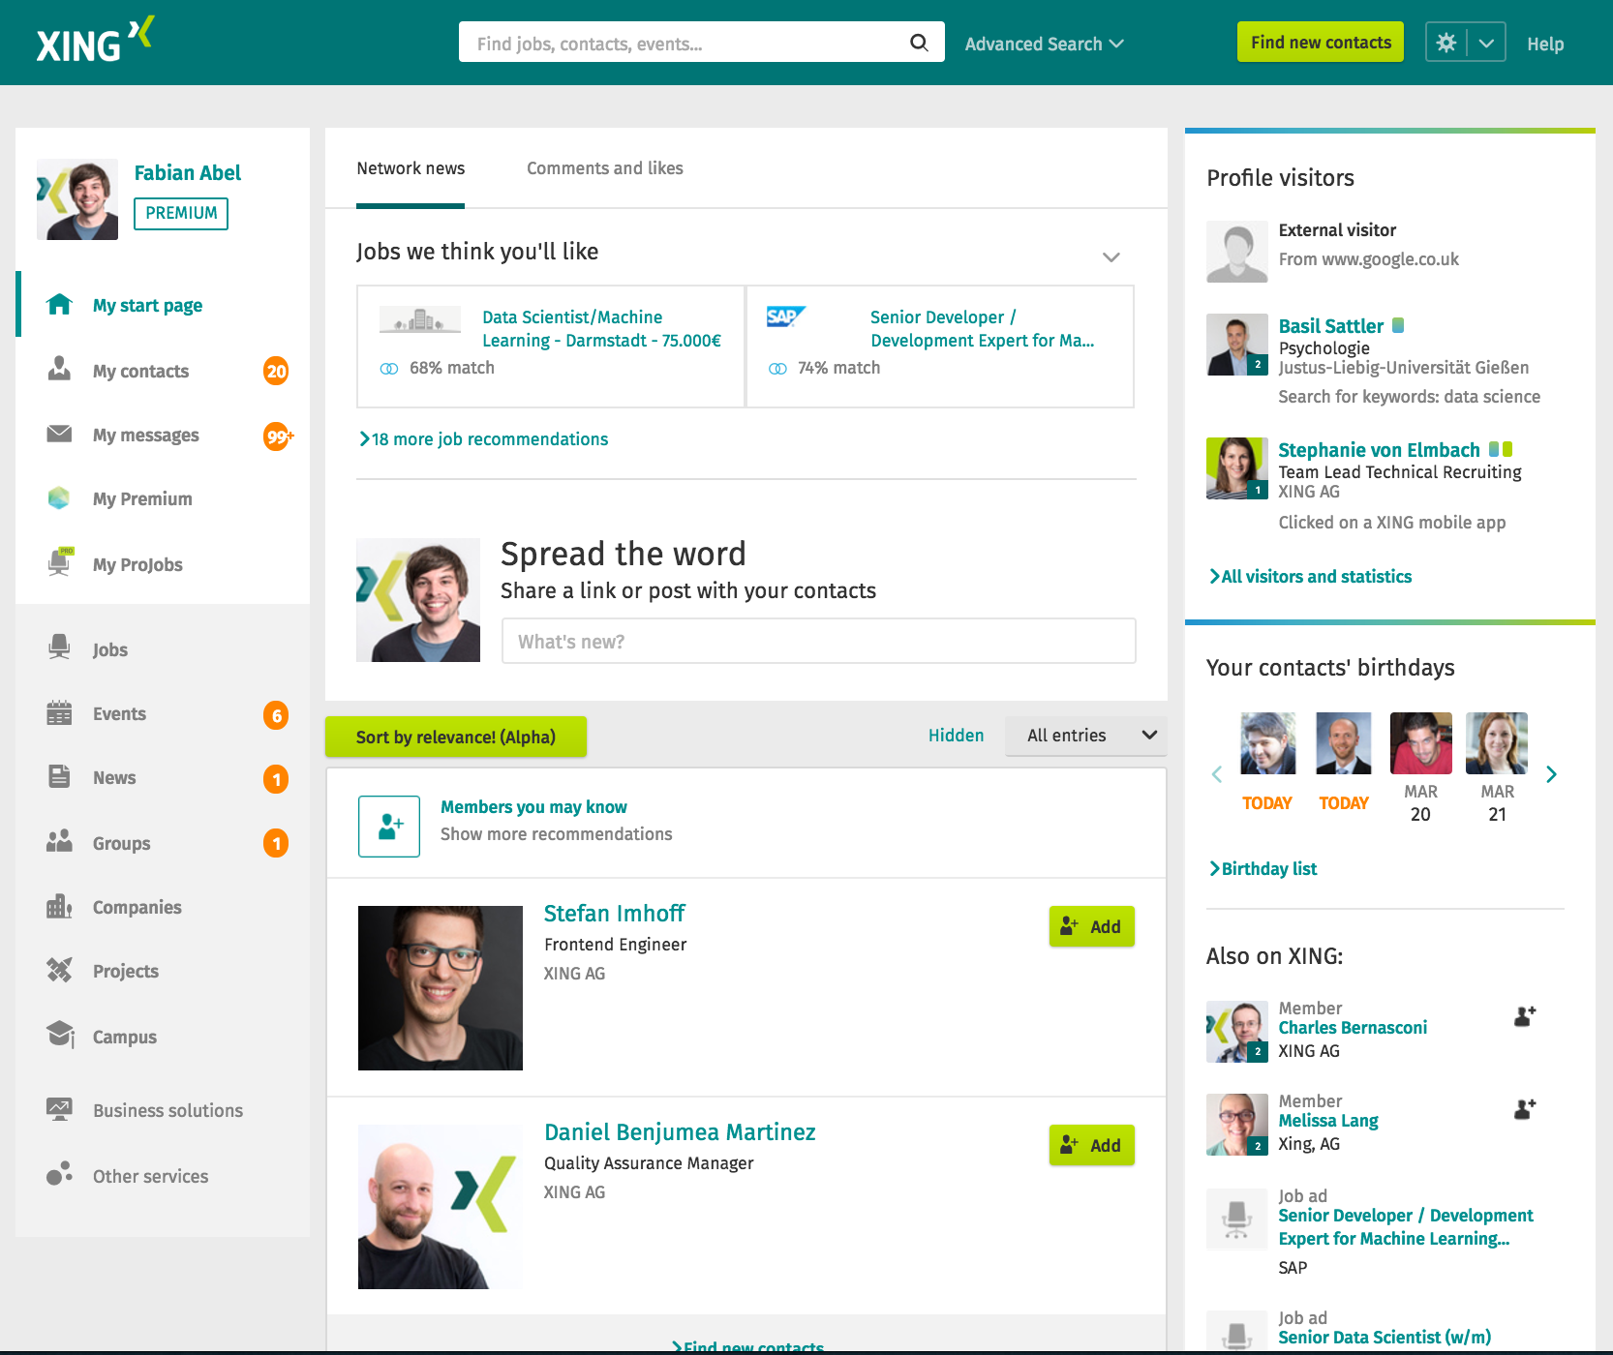
start page

Slide 5
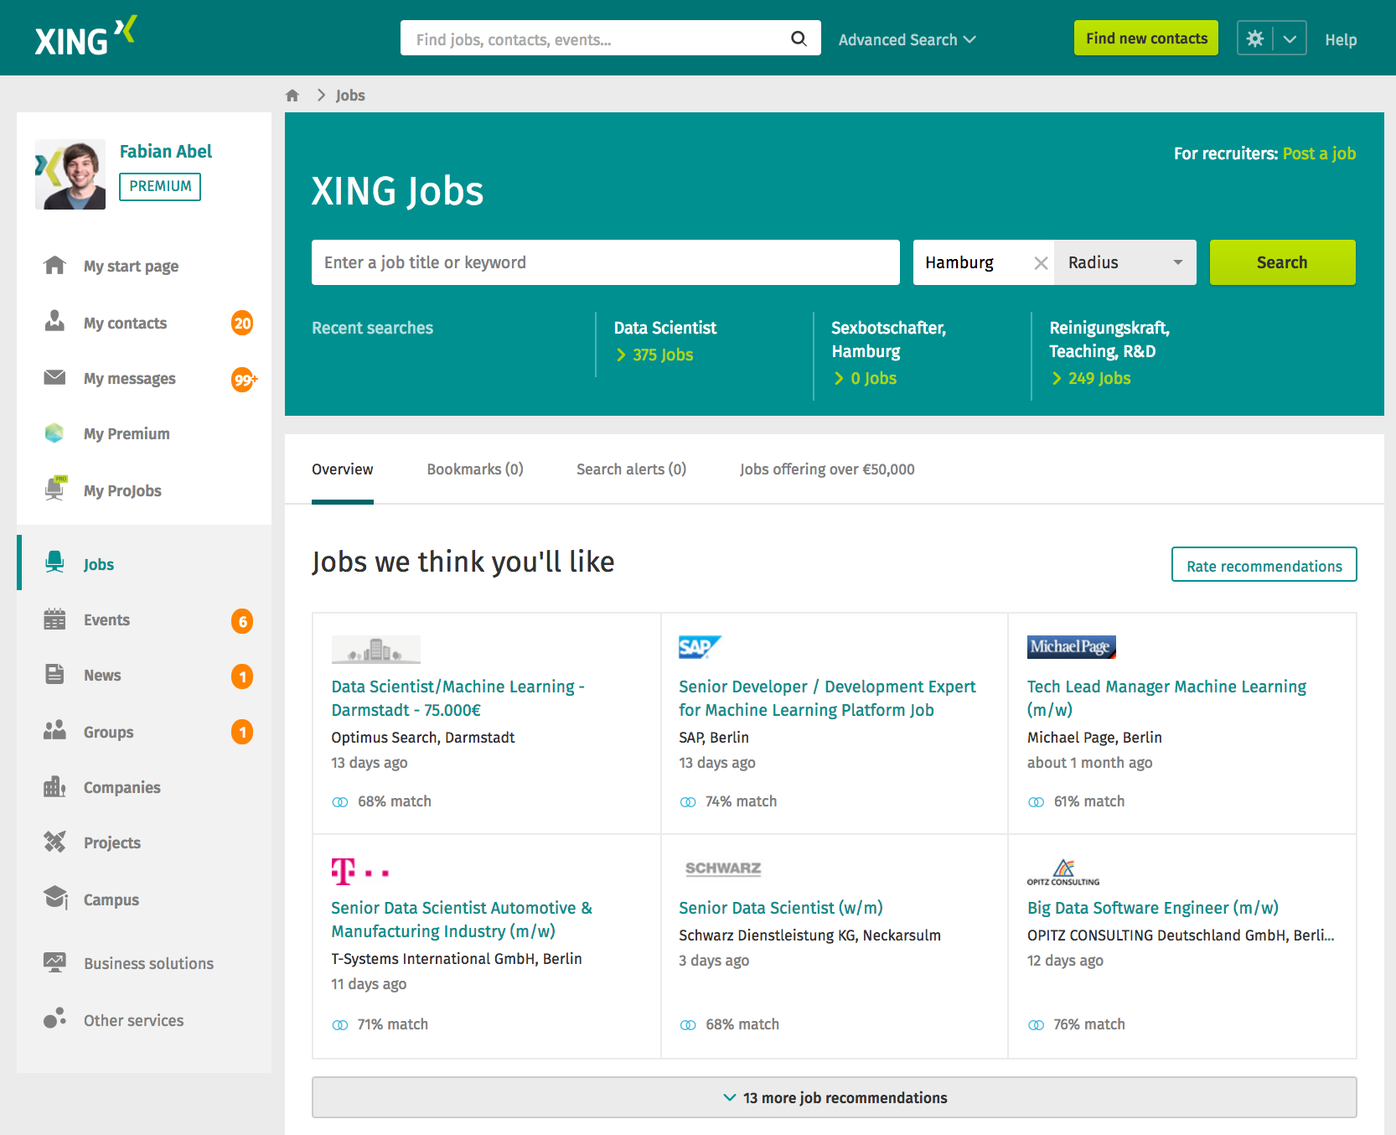
jobs market

Slide 6


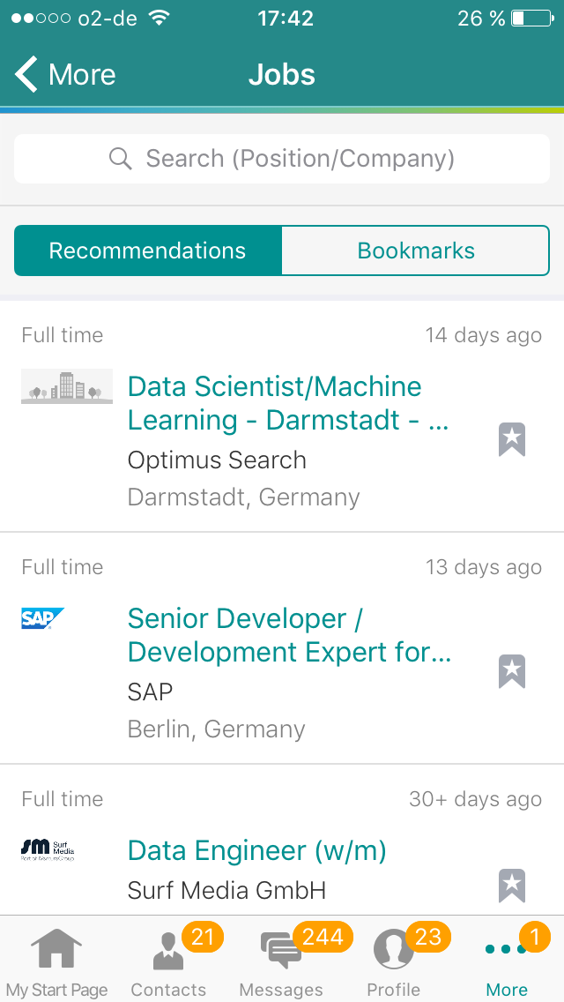
mobile
email

Slide 7



Goals / Triangle of contradiction
relevant recos
no spam
relevant candidates
high reach
Scala Dev, Hamburg
user
companies
high revenue (e.g. many clicks on paid content)
happy customers

Slide 8
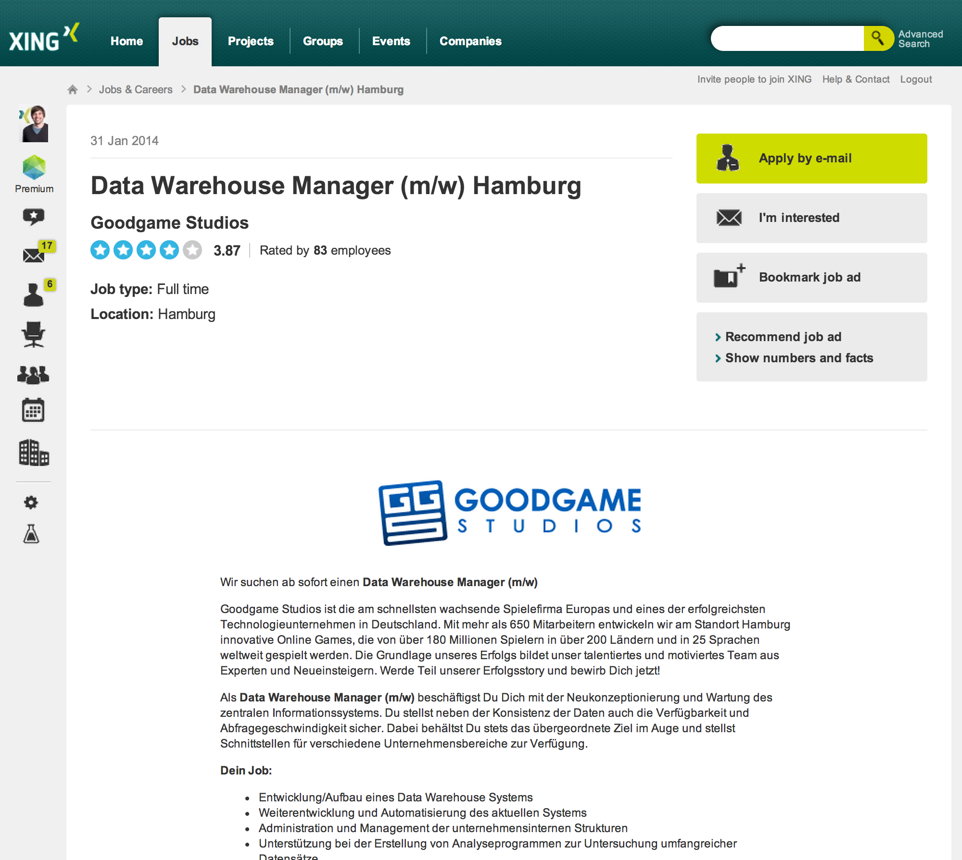

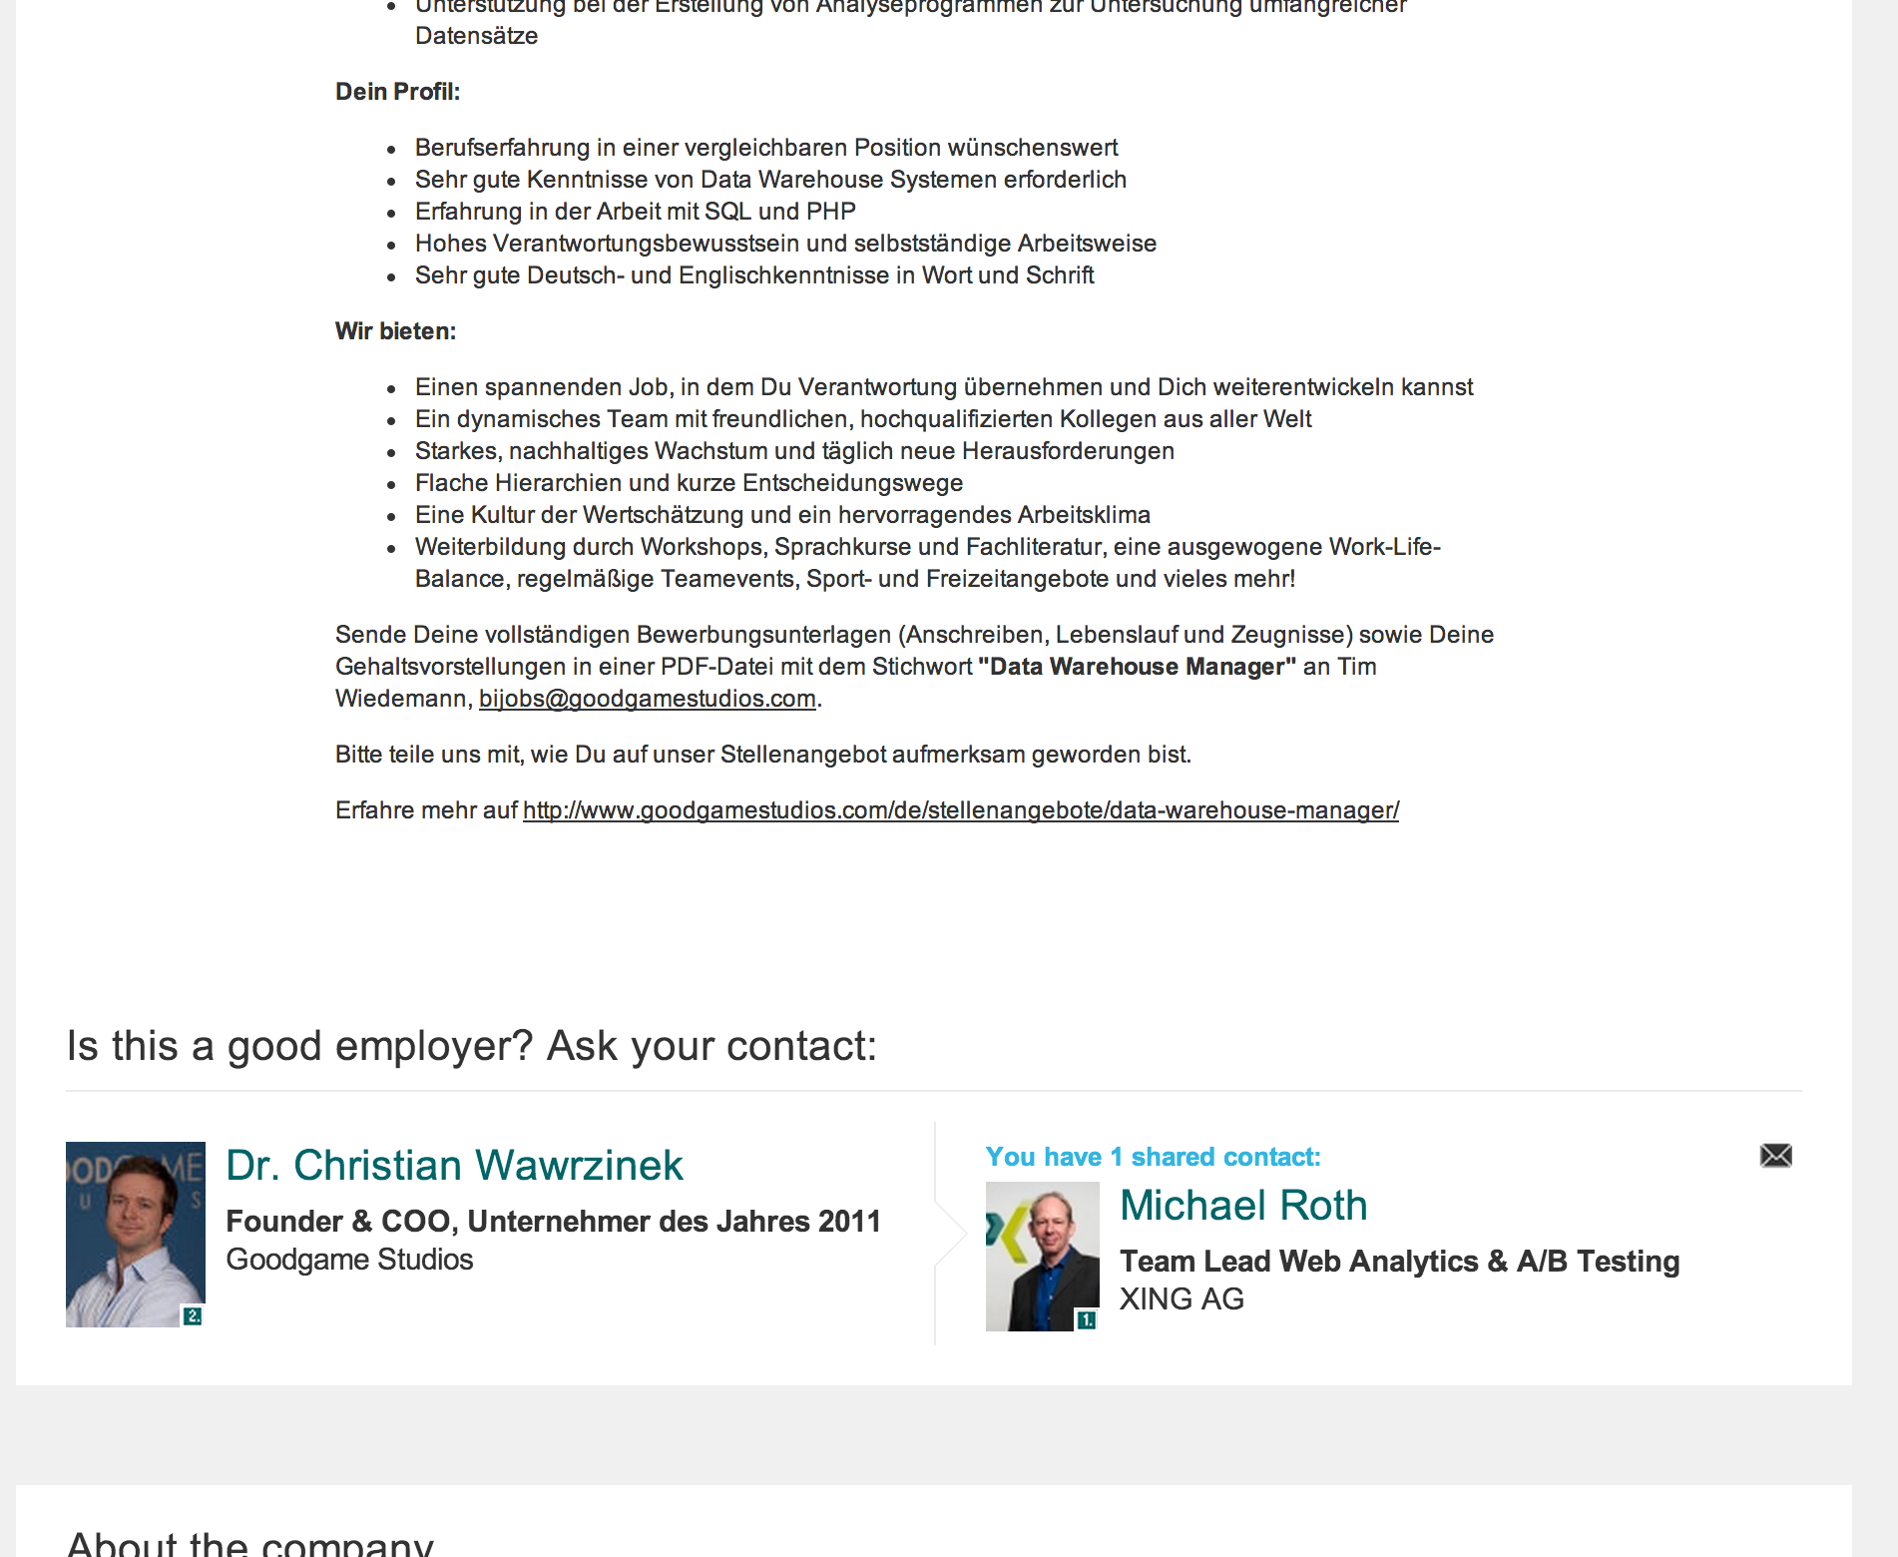
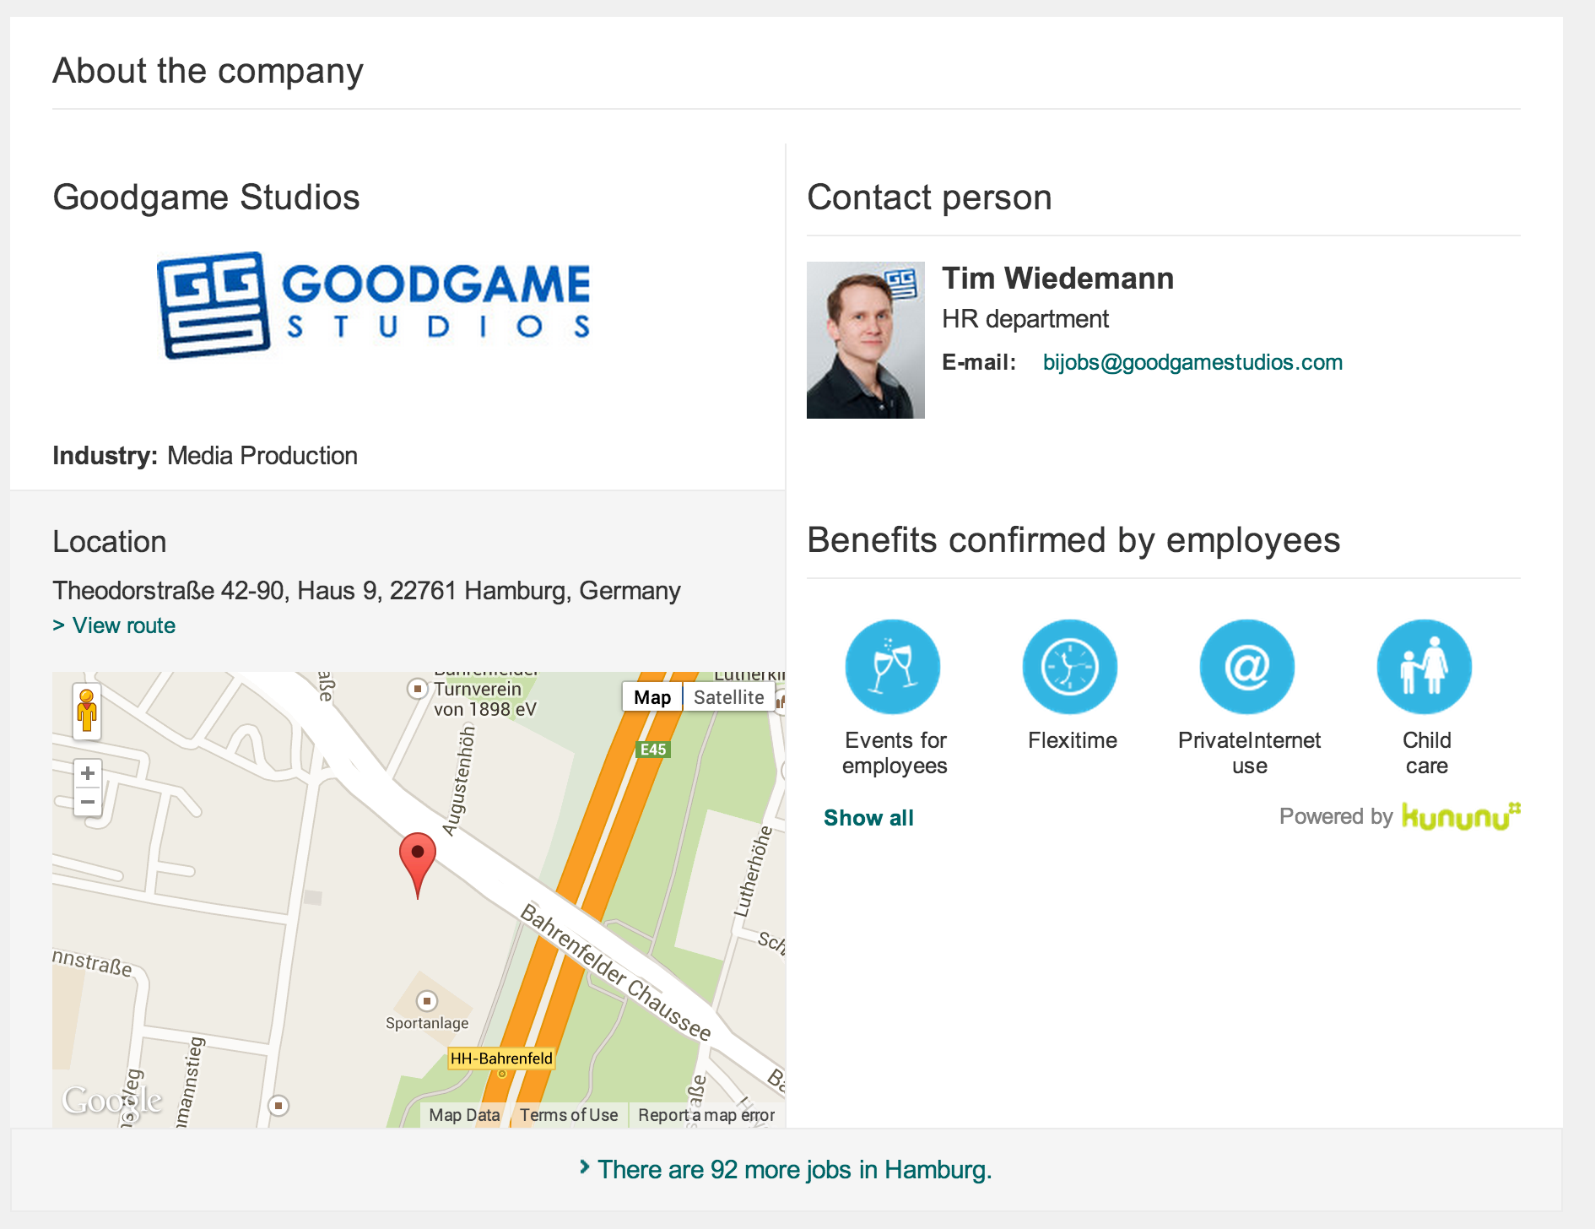
Key properties of a job posting
Title
Company
Employment type and career level
Full-text description
Employees of the company
Social benefits
Location

Slide 9




Key sources for understanding user demands
Profile
Social Network
Fabian Abel
Data Scientist
explicit and implicit connections
Skills
web science, data mining
skills & co.
Interests:
big data, hadoop
data
web
hadoop
similar users
clicks, bookmarks, ratings, shown
social media
scala
kununu
Interactions of similar users
big data
Interactions

Slide 10
Recommender strategies
Content-based filtering
explicit user profile
implicitly given interest profile / inferred attributes
Item-to-item recommendations (more like this)
(Pseudo) collaborative filtering

Slide 11









Collaborative filtering Theory: User-based and Item-based CF
User-Item-Rating Matrix
User-based CF:
Compare users based on their ratings (e.g. cosine sim.)
Use the n most similar users to predict a rating on an item
Java D.
SAP Co
Data En
Data Sc
BI Dev
Anna | 3 | - | 4 | - | 2
Julia | 2 | - | 5 | 4 | 1
Tim | 4 | 3 | - | 5 | 1
John | - | 4 | 5 | 4 | -
Item-based CF:
Compare items based on their ratings (e.g. cosine sim.)
Use the n most similar items to predict a rating from a user (simple weight average)

Slide 12
Collaborative filtering Reality: Ultra sparse User-Item Matrix and primarily implicit feedback
Java D.
SAP Co
Data En
Data Sc
BI Dev
Anna | - | - | 1 | - | -
Julia | - | - | - | - | -
Tim | - | - | - | - | -
John | 1 | - | - | - | -
High level of sparsity: classical collaborative fitering (incl. matrix factorization) does not work

Slide 13
Collaborative filtering Reality: Ultra sparse User-Item Matrix and primarily implicit feedback
Java D.
SAP Co
Data En
Data Sc
BI Dev
Pseudo CF:
Cluster users based on...
jobrole
skills
field of study
Recommend items that similar users (= clusters) interacted with
Anna | - | - | 1 | - | -
Data Sci | - | - | 32 | 18 | -
Tim | 524 | 3 | 1 | - | -
John | - | - | 2 | 4 | -
Data Scientists
Skilled
in Java
BI Dev
New item problem remains...

Slide 14

Content-based filtering Example: semantic search
[jobrole]
6940
Fabian Abel
Data Mining Expert
ontology
Data Scientist
Synonyms: Data Mining Expert, Data Mining Specialist, …
ES query
Skills:
ML, j2ee
[skills]
Interests:
Hadoop
162
263
473
Education:
Informatik
Hadoop
Synonyms: Apache Hadoop, …
JEE
Synonyms: J2EE, Java Enterprise, …
Machine Learning
Synonyms: Maschinelles Lernen, …
TFxIDF
[field of studies]
370
Computer Science
Synonyms: Informatik, Comp. Sci., CS, …

Slide 15
Content-based filtering Example: More-like-this component
Bookmarked, rated and applied-to job postings
Recommending similar items
q
q = trans ( )
1
2
3
1
2
3
4
5
6
Re-rank by similarity of topic model vectors
1
2
3
4
5
6
(Doc2Vec vs. LSTM)
Topic model vector representations
Anna
5
6
4

Slide 16

People freak out if we recommend something wrong!
→ Try to eliminate freakommendations (outliers)

Slide 17
Filtering and Re-ranking
career level filtering
less-like-this
same company filtering
boosting jobs from cities where people have contacts
boosting paid content
outlier filtering
...

Slide 18
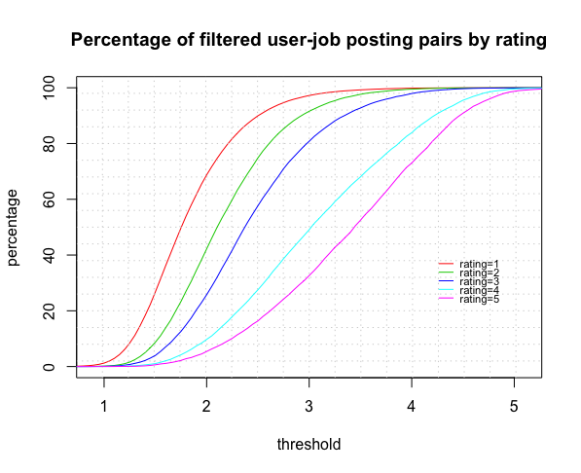
Outlier Filtering: Trade-off between killing bad recommendations and keeping good ones
Approach:
Predict a rating for each user and its top-x recommendations
Remove recos with a rating below the threshold
Percentage of filtered user-job
posting pairs by rating
good recos
bad recos
threshold
Example: with a threshold of 2.5 we kill 86% of the bad and 18% of the good recos

Slide 19
Bulding Recommender Systems

Slide 20











Slide 21
REST Service
C* / MySQL
~20
Job Recommender
REST Services
user ID
~7
~4
Elastic Search

Slide 22

Single threaded this would take up to 12 seconds!

Slide 23

How to make it faster? Do computations in parallel!

Slide 24
Internal recommender structure
DS₁
SR₁
DS₁
DS₂
F₁
SR₂
Merge
DS₂
RR…
DS₃
F₂
DS…
SR_{M}
DS_{N}
DS
Data Source
F
Filter
SR
Sub Recommender
RR
Rerank
Notes:
Stages
Asynchronously
Can be disabled
DataSource loads data, which is not a recommendation
Sub Recommender can only create / load recommendations
Filter can only remove entries
Rerank can only change the score

Slide 25
Mixture of Online & Batch Processing
Online data
Lookup or computation takes milliseconds
Often required when data must be up-to-date (e.g. contextual user info)
Examples:
User profile data
Contacts of the user
Negative feedback (e.g. ratings)
Pre-computed data (batch)
Takes minutes or hours to compute
Often required when a “complete picture” (also about other users) is necessary
Examples:
Interaction-based profiles
Association rules
Topic modeling (Doc2Vec, LSTM)

Slide 26

Example: Users in jobrole X typically click on
1. Get current jobrole of user
Profile Service
Job Recommender
REST service
user ID
JSON-formatted response
2. Get typical job postings
upon request
batch
Association rule miner
Export
Runs once every 30min
Notes:
Stages
Asynchronously
Can be disabled
DataSource loads data, which is not a recommendation
Sub Recommender can only create / load recommendations
Filter can only remove entries
Rerank can only change the score

Slide 27
Deployment of RecSys Models

Slide 28
Examples of models used in production
Use Case | Type of model
Categorizing job posting | Logistic regression (>100k features)
Enrichment of job postings | Hierarchical Clustering (hierarchical K-Means)
Identifying similar job postings | Doc2Vec-based topic modeling; LSTM
Pseudo-CF | Association rule mining
Outlier filtering | XGBoost (~100 features, optimizing RMSE)
Core Ranking of job recos | XGBoost (~140 features, optimizing pair-wise loss)
Estimating willingness to change jobs | XGBoost (~90 features, optimizing cross entropy)
Estimating user preferences | Naïve Bayes
… | …

Slide 29
Degree of automation in ML
high
ML with high degree of automation
Models and features are automatically constructed, refined, optimized
Models and features are automatically (re-)learned, refined, optimized
Model-based algorithms are frequently re-learned (semi-automated, re-prod.),
Degree of automation
ML with human supervision
Model-based algorithms are manually learned once (not reproducable)
Model-based algorithms are manually learned once (not reproducabl
Algorithms based on data analysis
pre-ML
Hacking: hand-crafted algorithms
low
Involvment of humans

Slide 30

Automated learning &
deployment of ML models
turn on if difference
Model com-parison
A/B
Training & test sets
Learning hyper parameters
Model storage
Model selection
Ground
Truth
Hyper Parameters
2017-01-01
last
REST service (production)
Features
Train Model
current
Notes:
Personalised recommendations based on the user‘s behaviour

Slide 31
Thank you
Contact: katja.niemann@xing.com
http://bit.ly/data-science-team

Slide 32

XING is hiring
Data Engineers
and
Data Scientists

